Slide 1


Slide 2
Using your Web Browser,
Open this URL:
Click on the workshop you’re attending, and find:
1
http://mlhlocal.host/lhd-resources
2
Setup Instructions
The Code Samples
A demo project
A Workshop FAQ
These Workshop Slides
More Learning Resources
Notes:
What to Say:
Tell attendees we are going to check them in for the event
Once attendees check in, they will receive an email with the items listed on the slide
Attendees must check-in to get credit for attending this event
What to Do:
Confirm that everyone has checked in by asking participants to give you a signal when they receive the email.

Slide 3

Our Mission is to Empower Hackers.
65,000+
HACKERS
12,000+
PROJECTS CREATED
3,000+
SCHOOLS
We hope you learn something awesome today!
Find more resources: http://mlh.io/
Notes:
What to Say:
Major League Hacking (MLH) events are meant to bring hackers together so they can learn, build, and share.
Give participants a brief overview of Major League Hacking (MLH).
Tell participants they can learn more at http://mlh.io/
Example Talking Points:
TODO
Through Localhost MLH is rethinking technology education to reflect how hackers actually learn and how fast the industry moves.
Here's some quick facts about MLH:
Each year, MLH supports over 65,000 hackers around the world at events they facilitate
Those students create more than 12,000 amazing projects together
MLH is a global organization that empowers hackers in more than 400 cities and growing every day

Slide 4
What will you learn today?
1
How to create an FAQ bot with Microsoft Azure
2
How to use Visual Studio Code
3
How to deploy your Web App with Mirosoft Azure and GitHub
Notes:
What to Say:
Explain to participants what they will learn today
Learning is a core part of being a hacker and today they are going to learn something new
What to Do:
Get participants excited about the experience.

Slide 6
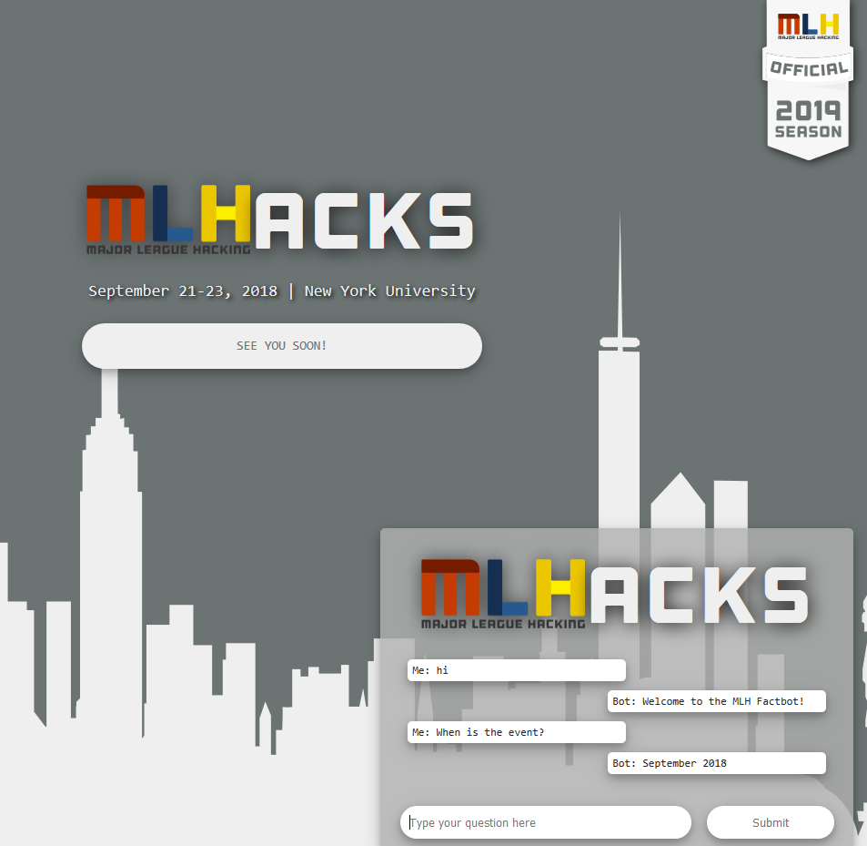
What You'll Be Building
http://mlhlocal.host/azure-bot-demo

Slide 7
What's a Bot?
Often it’s easier to chat with a bot than to search/read through a wall of text. “Chat Bots” use Natural Language Processing to match user messages to appropriate responses.
When does the store open?
9am every day
User
Do you have oranges?
Bot
No, but we have bananas!

Slide 8

How You'll Build It
We'll be using several tools to make building this app as easy as possible.
JavaScript to make a single web app that can receive information from a user, send it to the bot, and return a response.
Microsoft Azure to make the bot and host it publically.
Visual Studio Code + Git to edit and deploy the code.

Slide 10

Key Advantages of
Microsoft Azure is a cloud platform with more than 100 services and tools for developers.
95% of the Fortune 500 companies run on Azure (and learning these skills can help you land your first job!)
Easily deploy Web Apps, Mobile Apps, Databases, Data Science and AI Apps, Blockchain, Analytics with pre-built configurations
Supports a wide range of
Open source libraries (Node, .NET core, spark, hadoop, kafka)
Programming languages (Python, C#, JavaScript, Java, Ruby)
Operating systems (iOS, Android, Windows, MacOS, Linux)

Slide 11
Please Note: We recommend completing this entire workshop in an Incognito Window in Chrome.

Slide 12
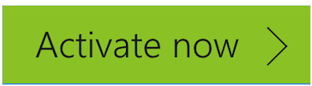
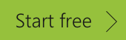
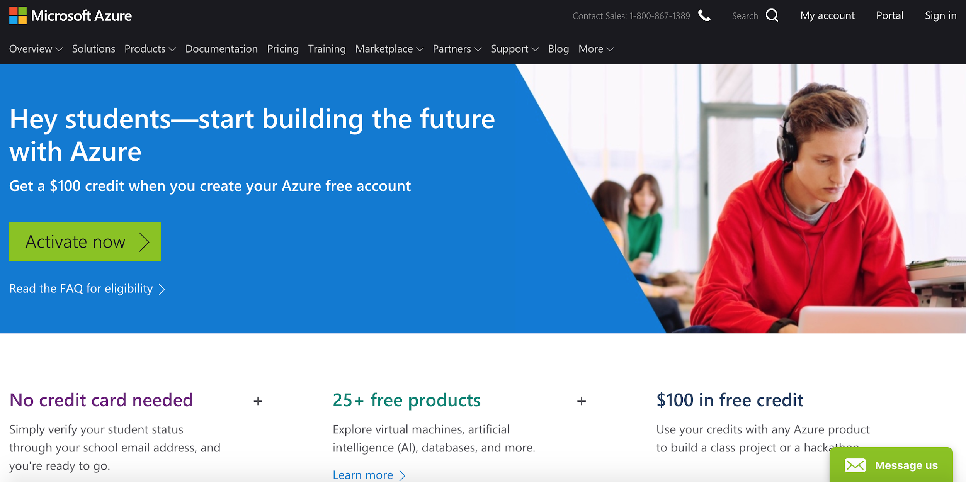
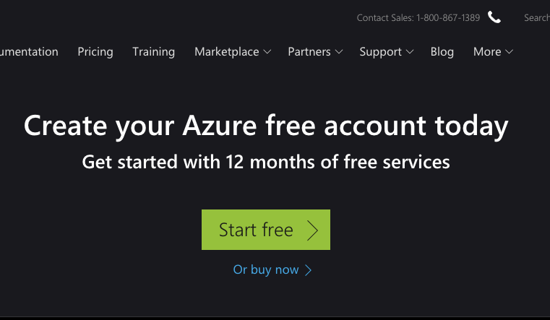
Create Microsoft Azure Account
http://mlhlocal.host/azure-student
http://mlhlocal.host/azure-nonstudent
Navigate to the top URL if you have a student email address and the bottom one if you don't. Select or .

Slide 13
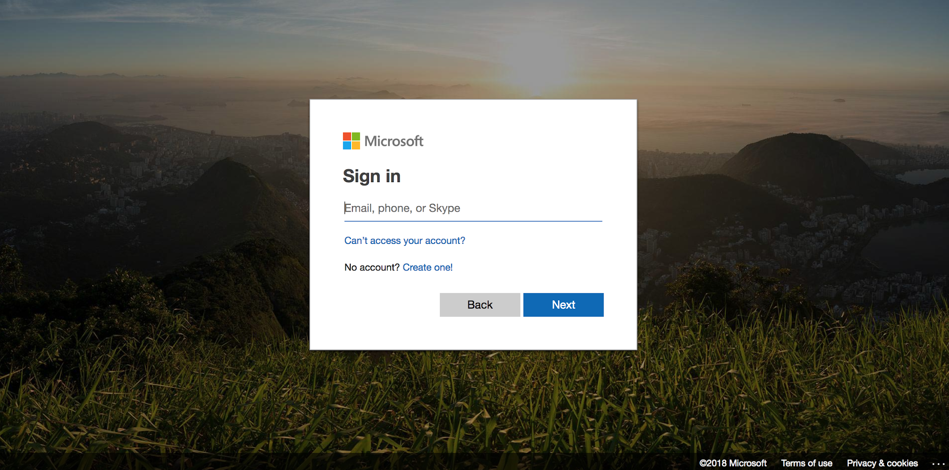
Create Microsoft Azure Account
Log in (or Sign up) with a Microsoft account

Slide 14
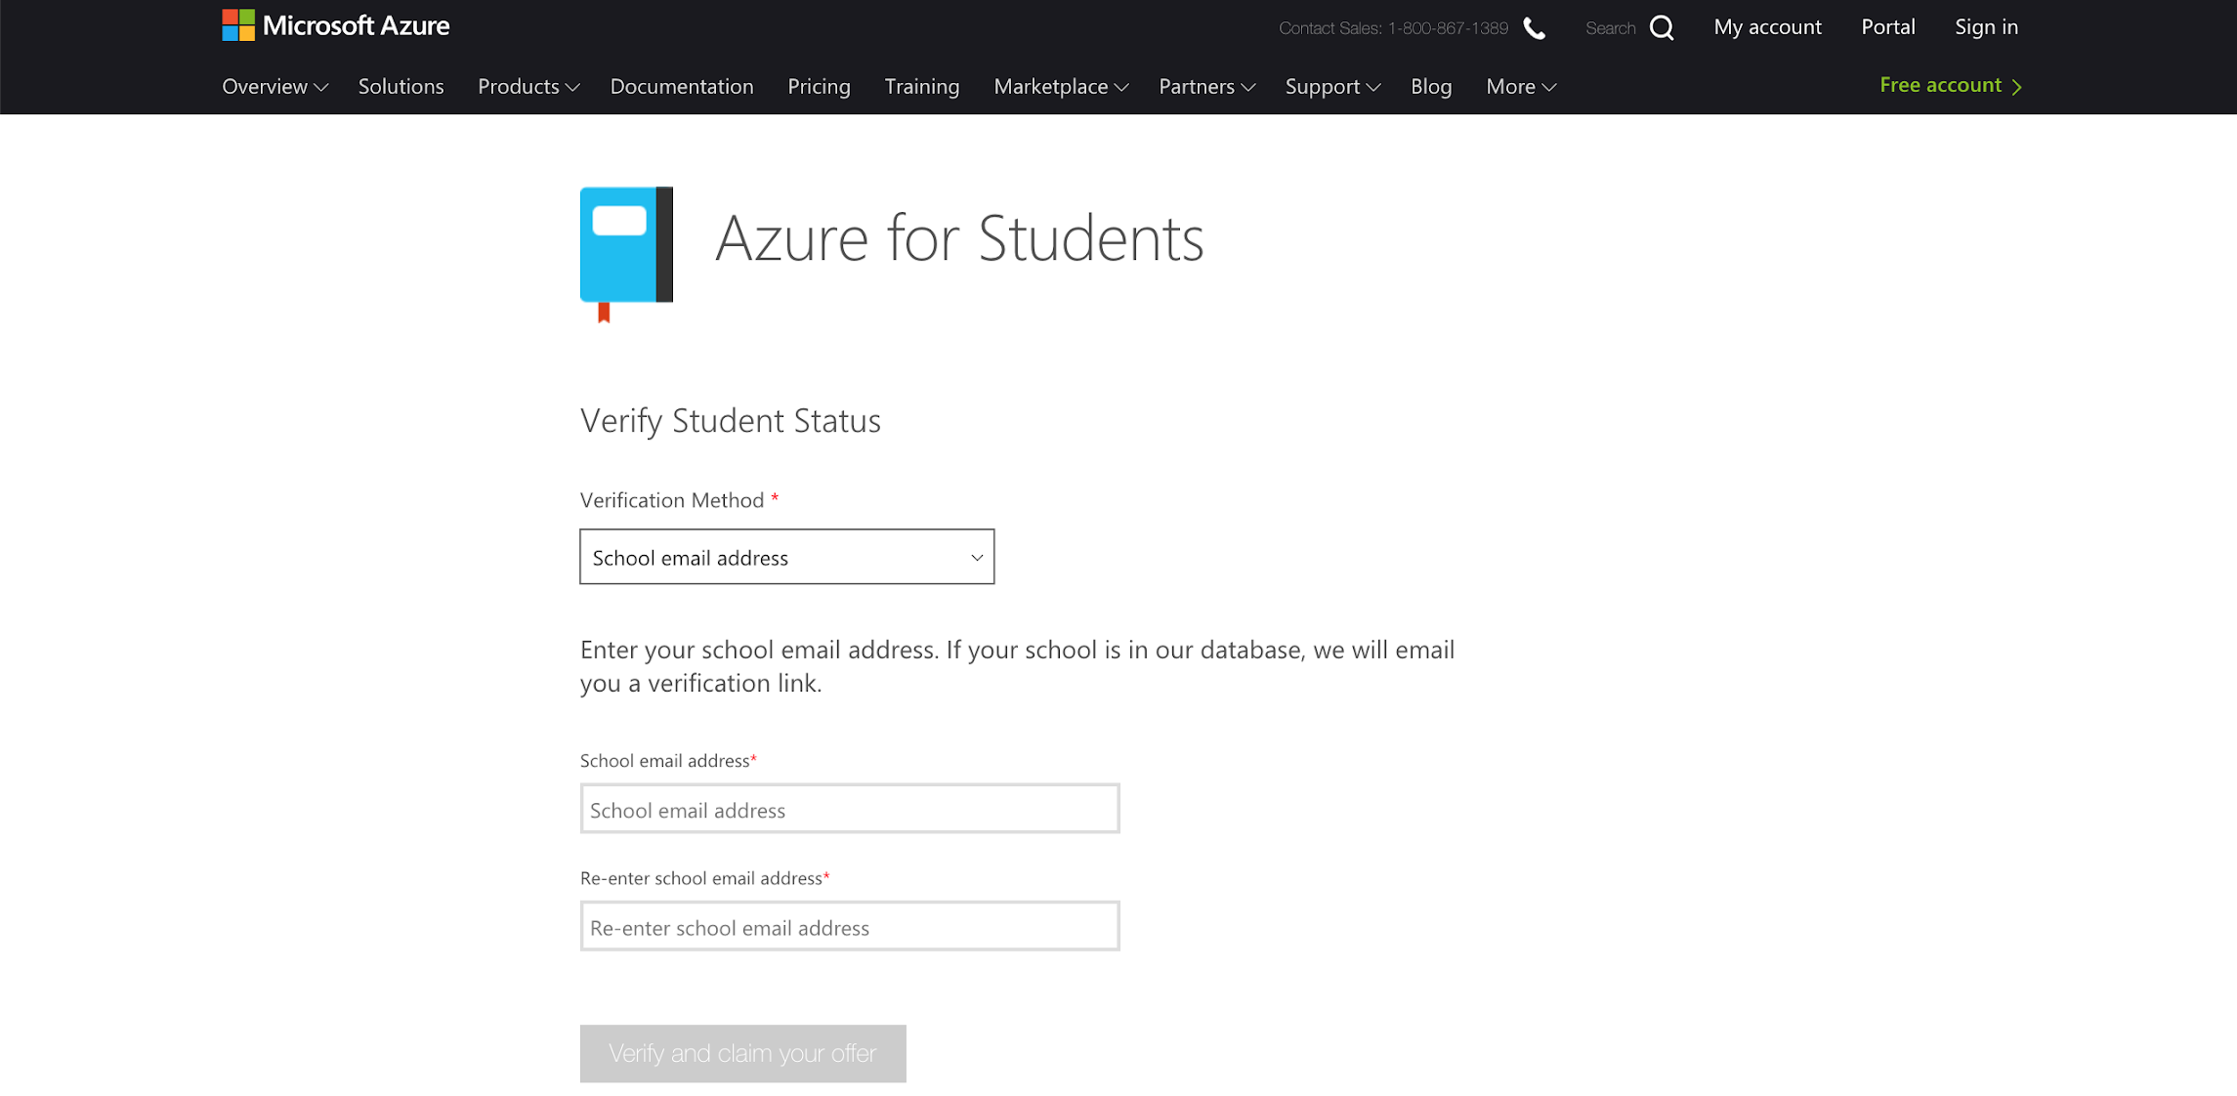
Create Microsoft Azure Account
Enter your school email address (ending in .edu), then follow the verification URL in the email sent to that address.
Choose school email address
Enter school email address

Slide 15
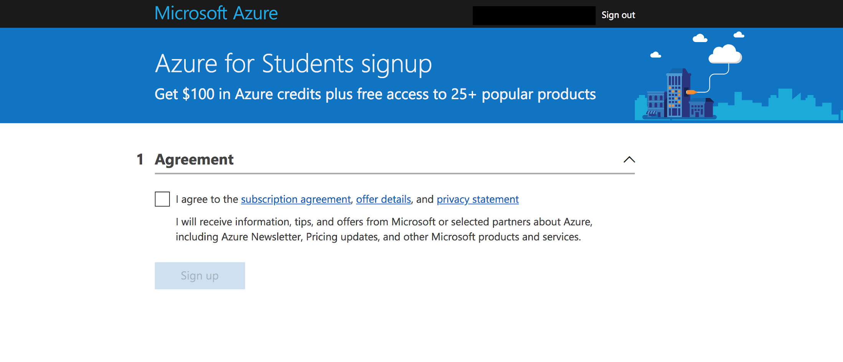
Create Microsoft Azure Account
Accept the terms of service and start using Microsoft Azure!

Slide 16
Microsoft Azure is a cloud platform with awesome developer tools. However, we're not going to write our code on Azure; that's what Visual Studio Code is for!

Slide 17
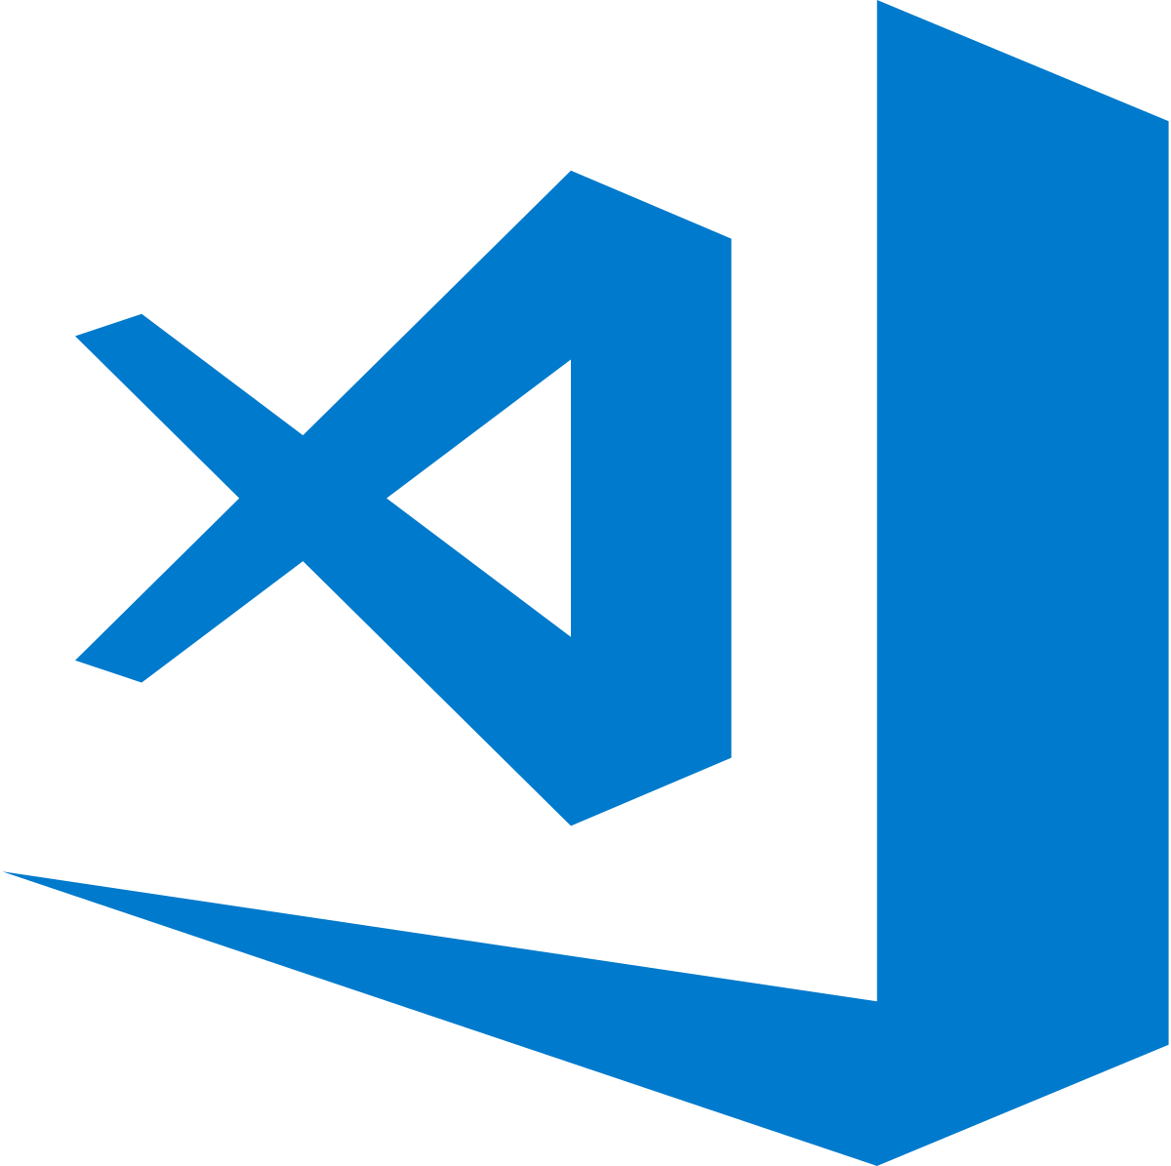
Key Advantages of Visual Studio Code
Visual Studio Code is a simple, code-centric integrated development environment (IDE).
Available for Mac, Linux, and Windows
Key features include debugging, version control with Git, and intelligent code completion
Supports 36 programming languages and offers customized tools and plug-ins to make your dev environment your own!

Slide 18
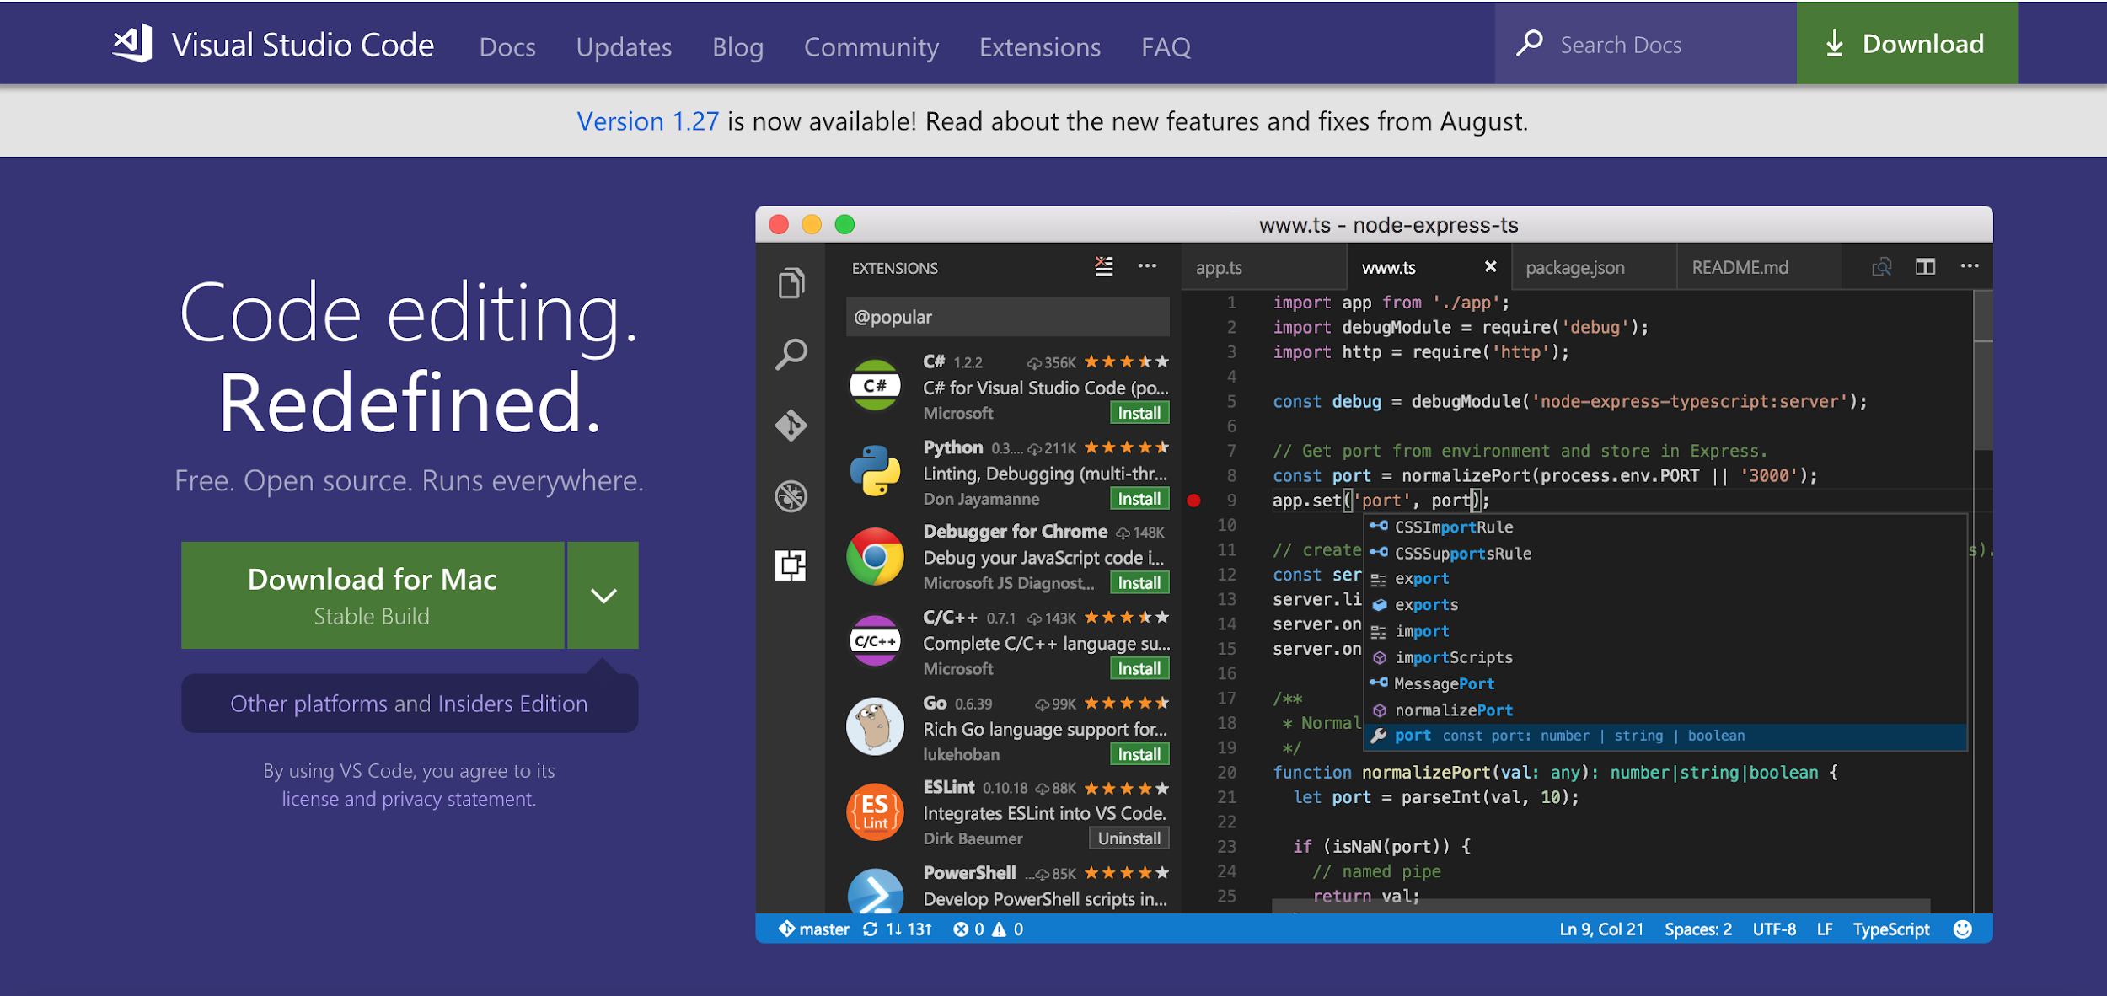
Download Visual Studio Code
http://mlhlocal.host/vscode
Follow the URL and select Download.
Notes:
Emphasis on Visual Studio Code, not Visual Studio generally

Slide 19
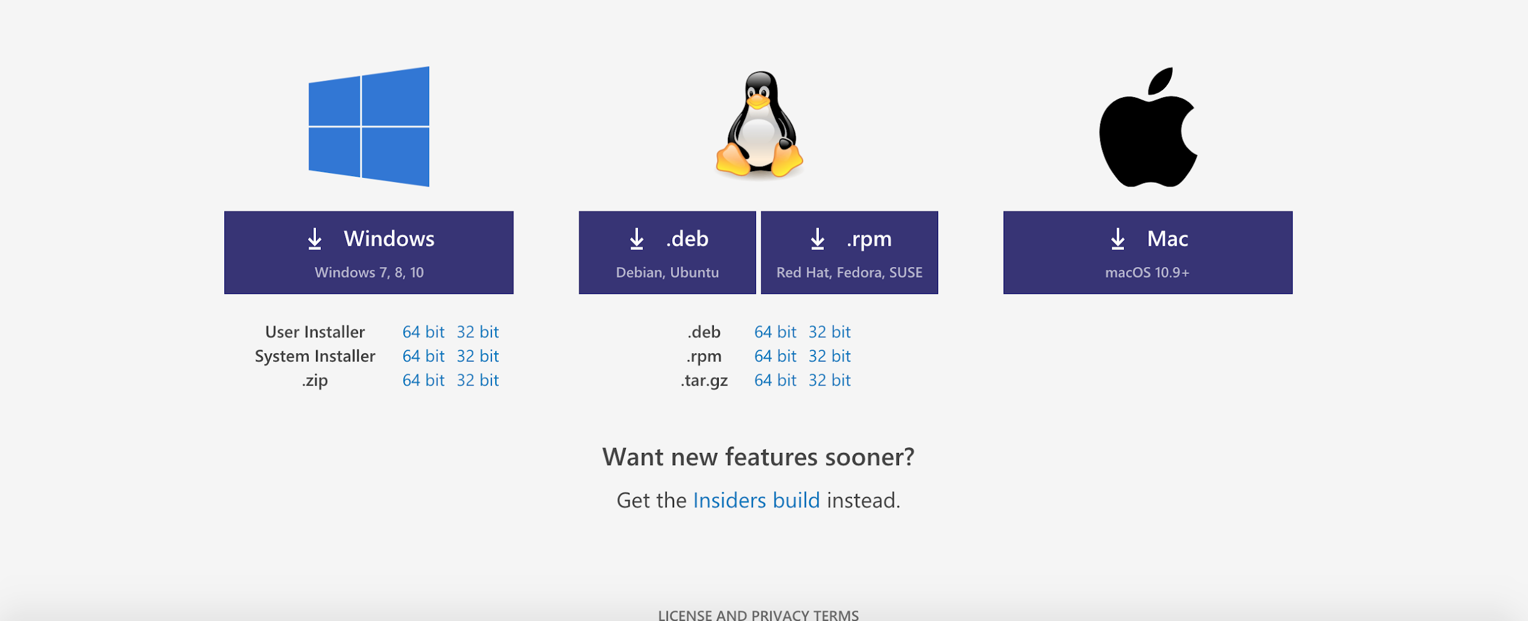
Download Visual Studio Code
(If you're having trouble, scroll to the bottom of the page and manually select the correct package for your system)
For PC
For Mac

Slide 20
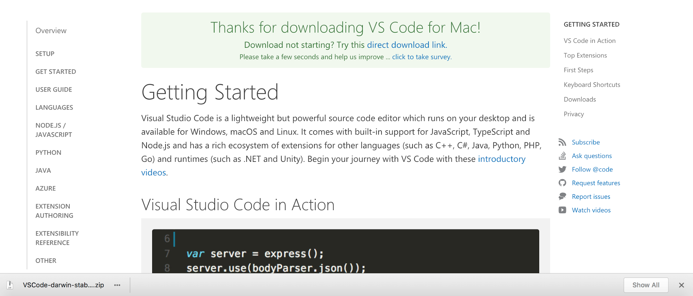
Download Visual Studio Code
Open the VSCode .zip file after it has finished downloading to set up Visual Studio Code.
Your browser may let you open the file directly from the download page...
...or you may have to open your Downloads folder and select the .zip file:

Slide 21
Visual Studio Code has many excellent features such as integrating directly with Git for version control.
Let's get set up with Git!

Slide 22
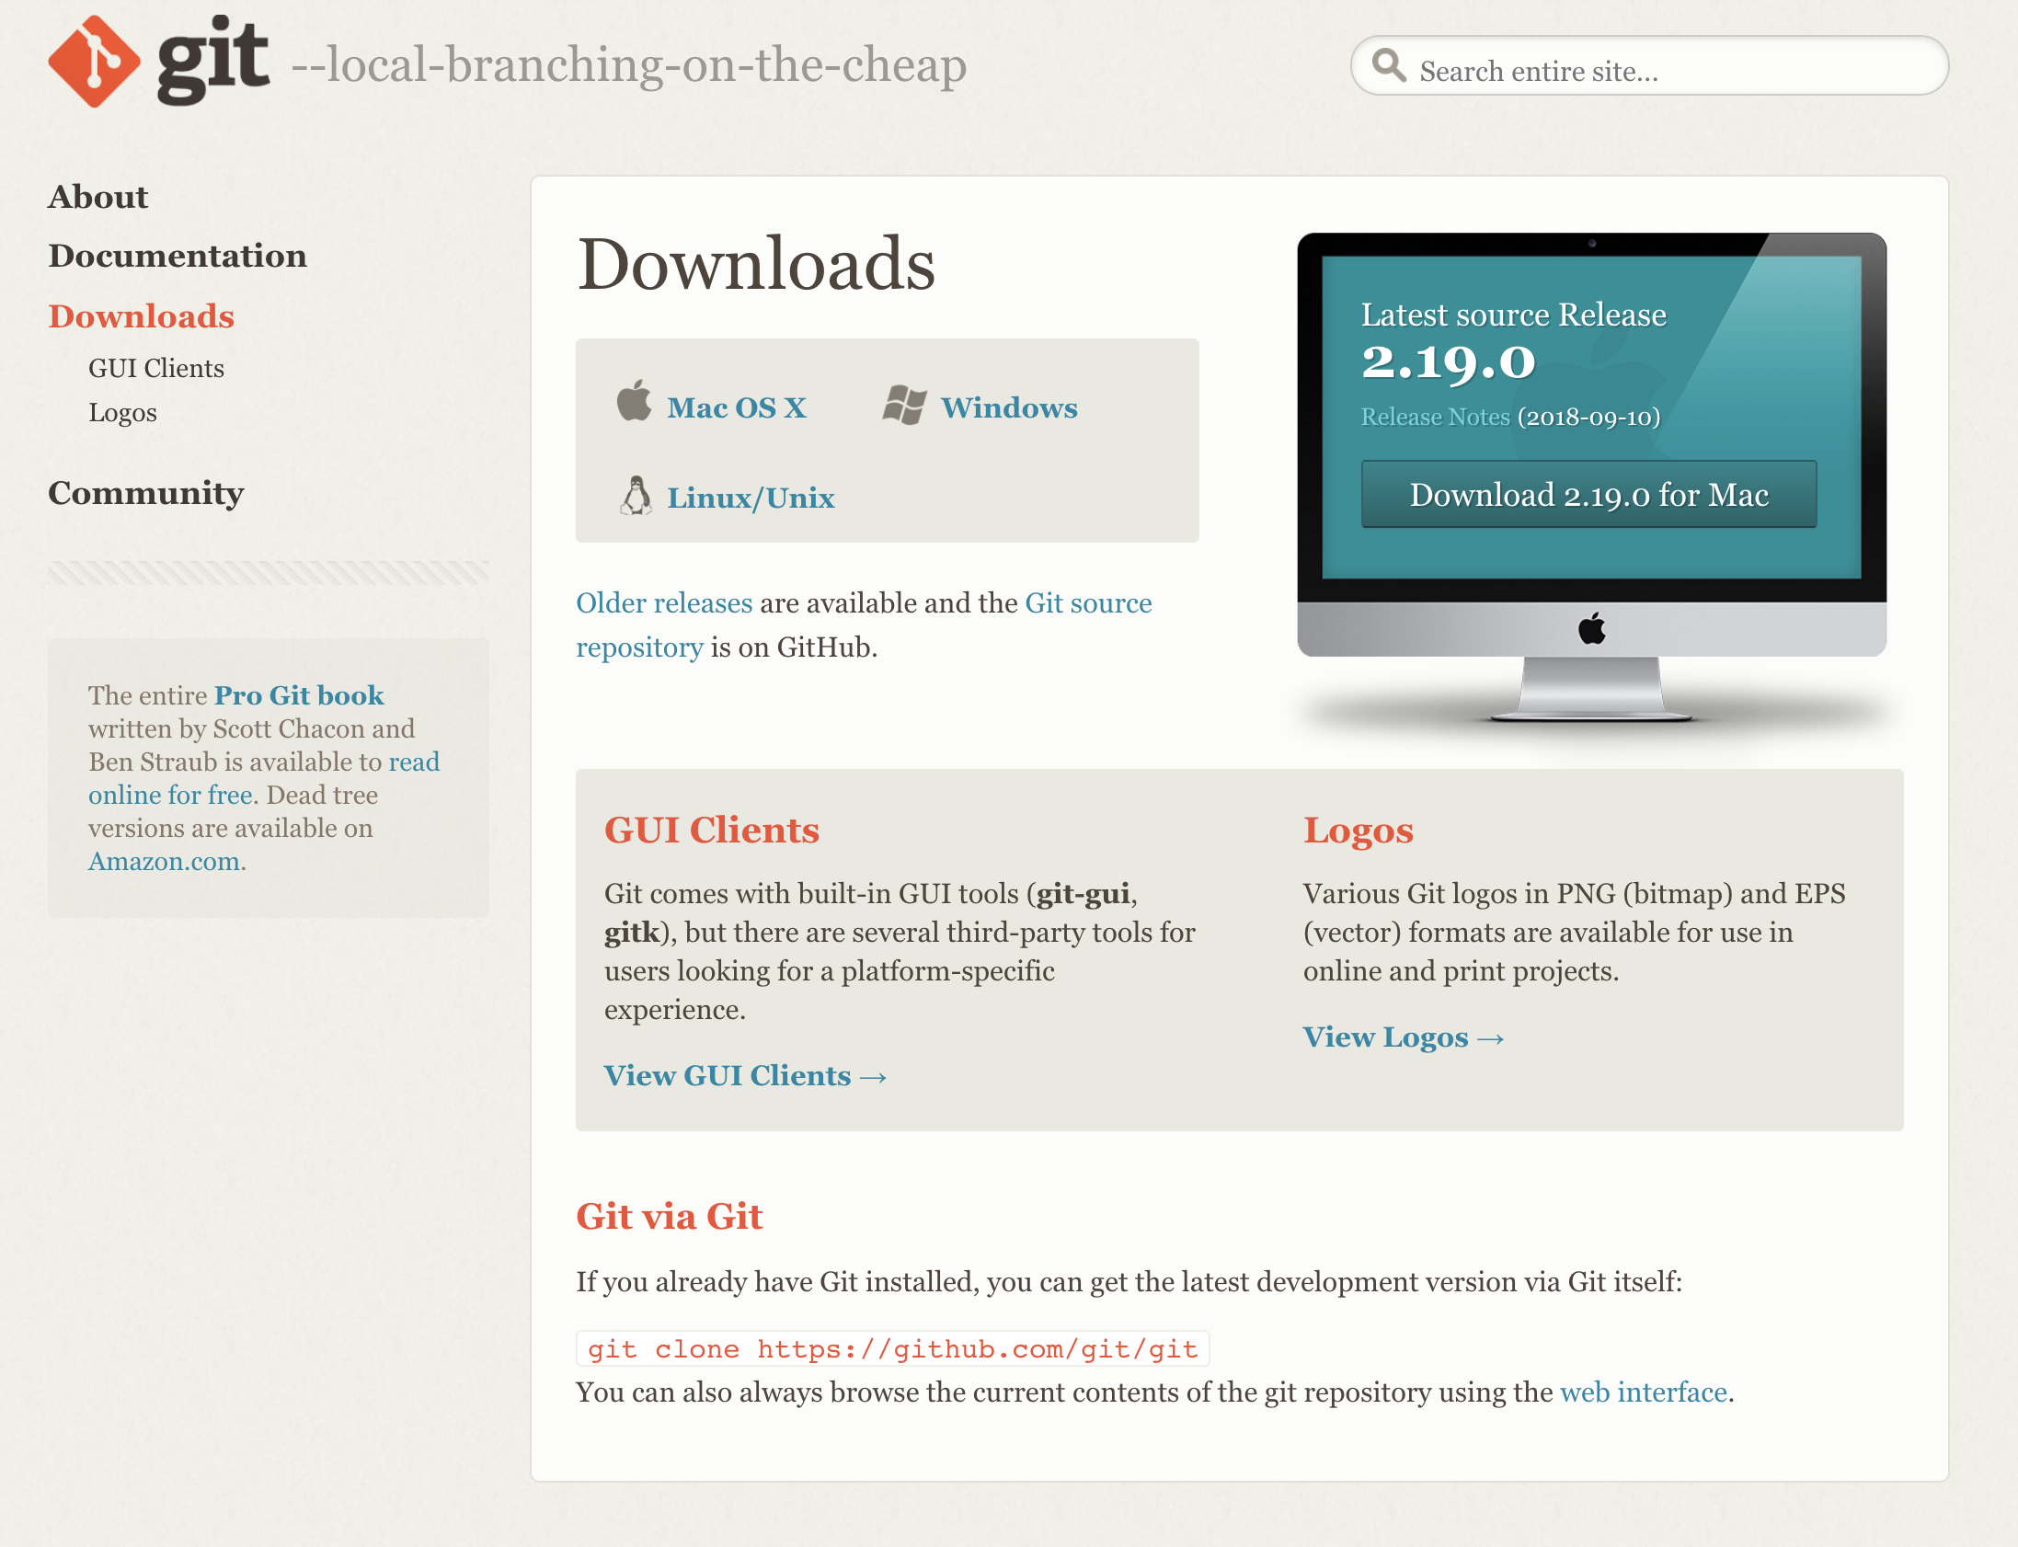
Hello, Git!
Git is a version control system that we'll use to save changes and deploy our app with Azure. We need to install Git!
Visit the URL above.
Select your operating system.
Follow the prompts to install Git!
http://mlhlocal.host/install-git

Slide 23
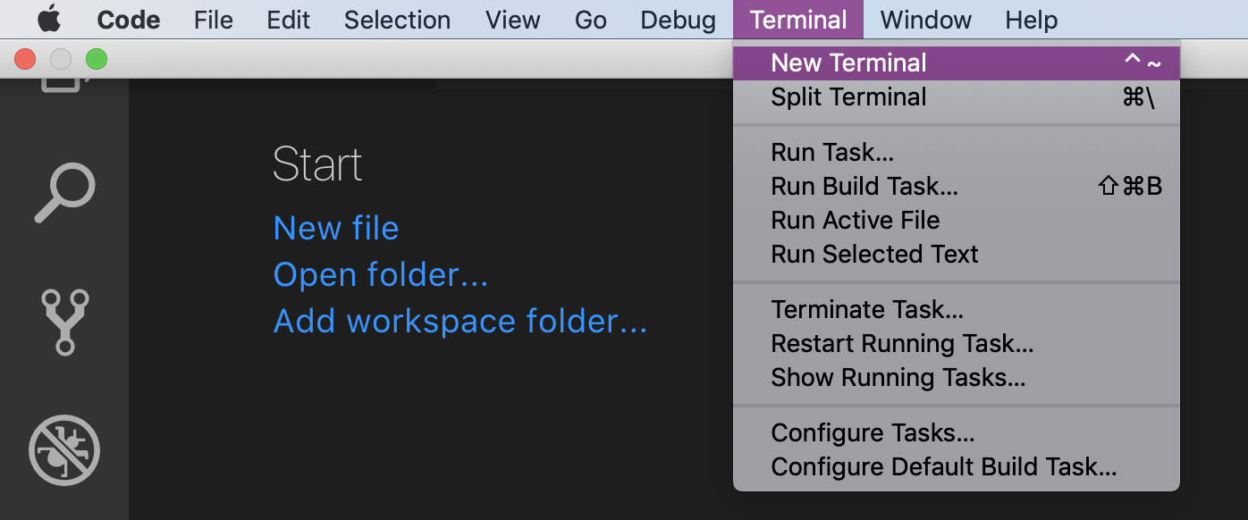
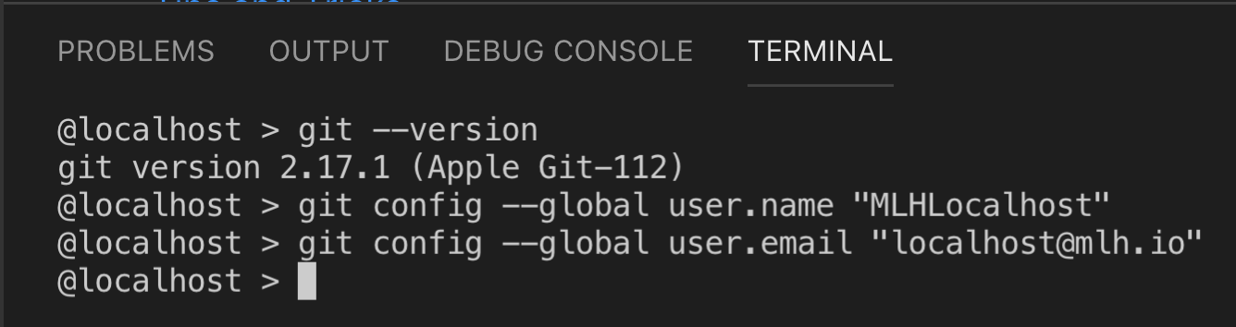
Configure Git Locally
We need to run two commands so Visual Studio Code can use Git.
Open Visual Studio Code.
Open a New Terminal.
Type these commands but substitute your name and email address :

Slide 24
We also need to install Node, which will allow us to develop and test our app locally.

Slide 25
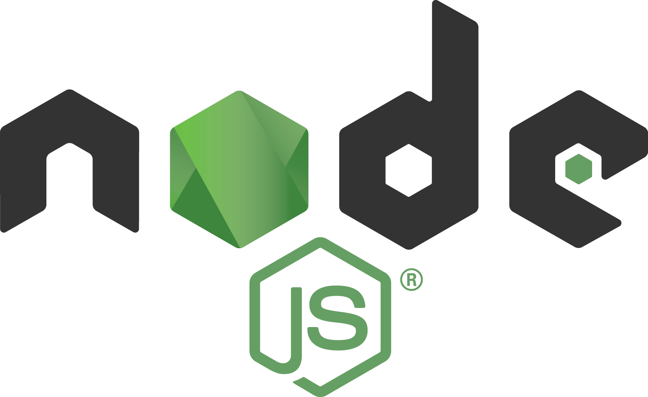
Hello, Node.js!
Remember from earlier that FAQBot is a Node app. What's Node?
Node.js is server-side JavaScript allowing us to create applications that send and receive information. You get to use the same language on the front-end and back-end!
Node.js is designed to quickly deal with multiple tasks (for example, receiving messages, updating databases, processing data) simultaneously.
It's open-source with thousands of packages available for use!

Slide 26
Install Node
Navigate to the URL that suits your computer and follow the installation instructions:
http://mlhlocal.host/node-mac
Download for Mac
http://mlhlocal.host/node-pc
Download for PC
http://mlhlocal.host/node-linux
Download Page to Select Linux Version
Notes:
What to Say:
Read the slide.
What to Do:
Recommend that they use the stable version if you are asked.

Slide 27
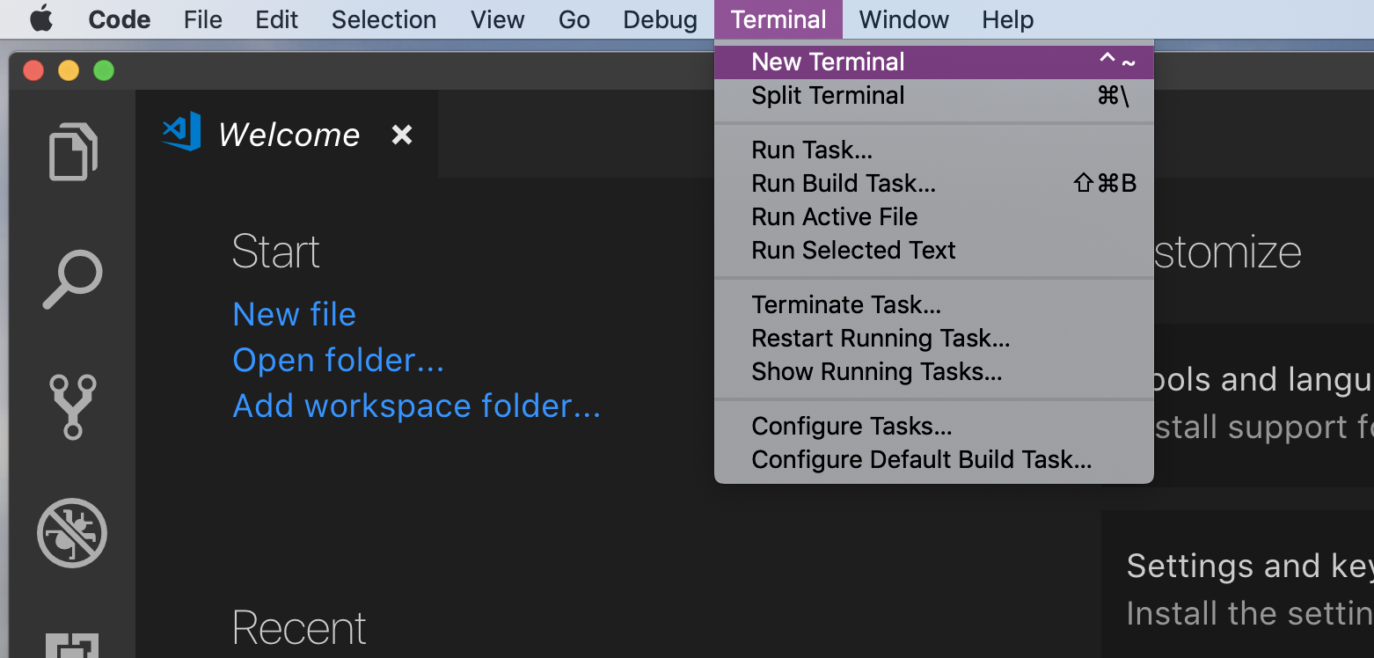
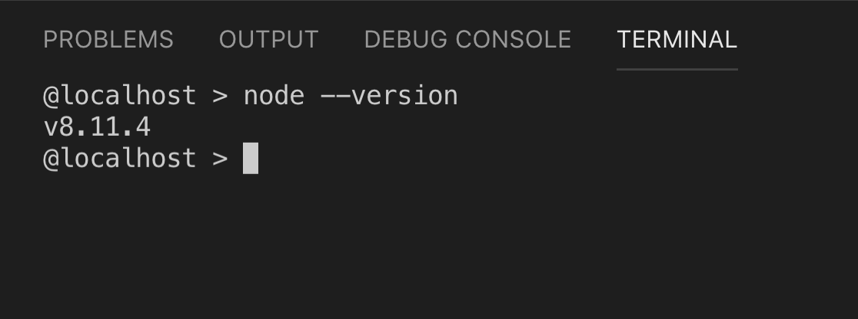
Check Node.js Installation
Open Visual Studio Code
Select Terminal -> New Terminal.
Type node --version in your terminal.

Slide 28
Great! You set up your Azure account, downloaded Visual Studio Code, and set up Git!
Now let's get a better understanding of how the FAQ Bot app works.

Slide 30
Download the Hacker Log Starter Code
http://mlhlocal.host/azure-bot-code
Navigate to the URL above.
A zip file of the code will be downloaded.
We need to unzip the file and open it in Visual Studio Code. These steps are different for MacOS and Windows – please follow the next steps very carefully depending on your operating system!

Slide 31
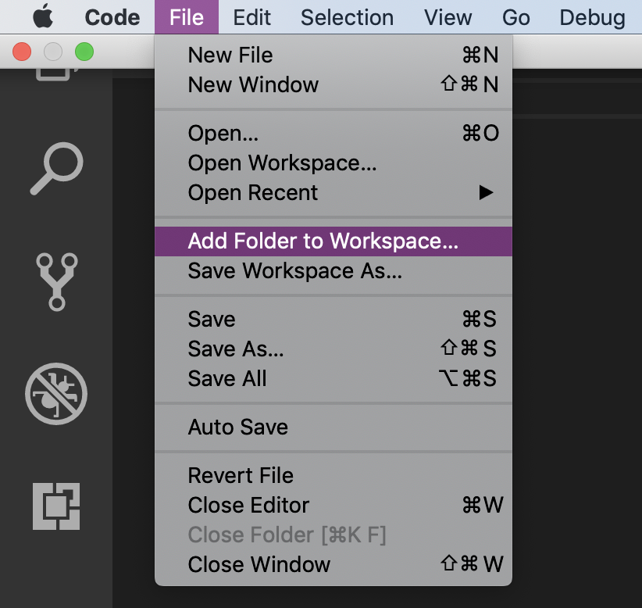
Add Project to Visual Studio Code: MacOS
Click the downloaded zip file. It will be automatically unzipped.
In Visual Studio Code, Click File -> Add Folder to Workspace.

Slide 32
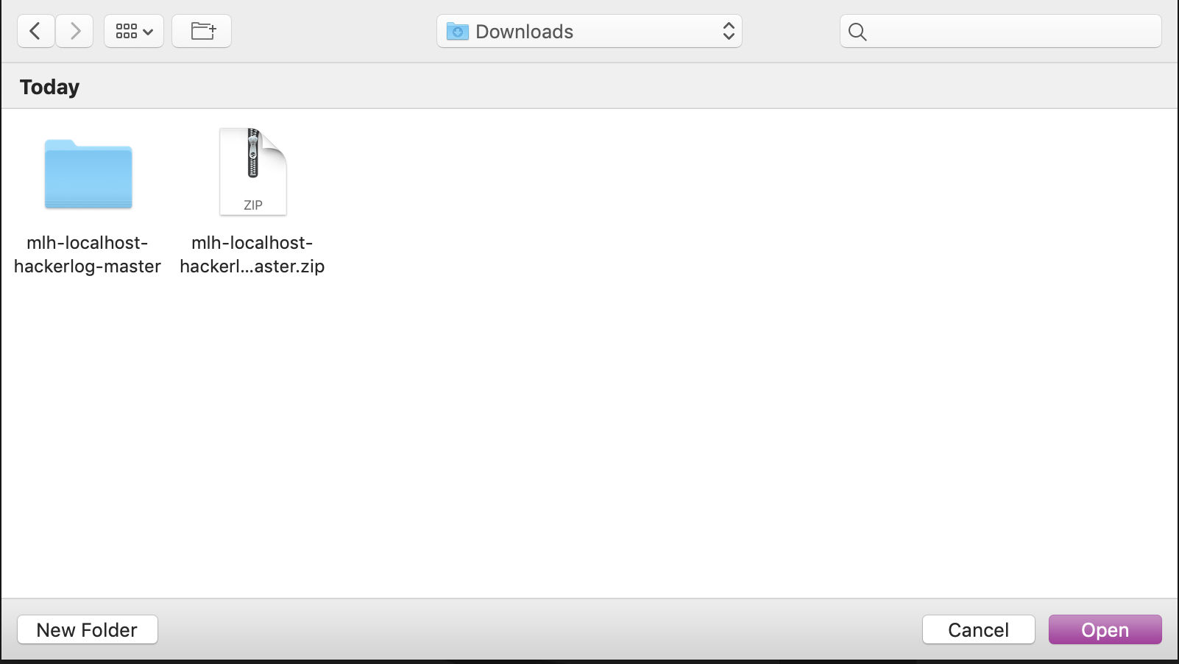
Add Project to Visual Studio Code: MacOS
In the file navigator modal, navigate to Downloads.
Click mlh-localhost-azure-bot-master.
Click Add.

Slide 33
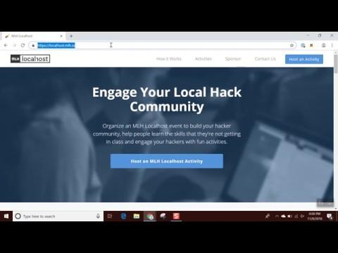
Add Project to Visual Studio Code: Windows
Click the download.
Click mlh-localhost-azure-bot-master.
Click Extract at the top, then click Extract All.
Delete mlh-localhost-azure-bot-master. Click Extract.

Slide 34
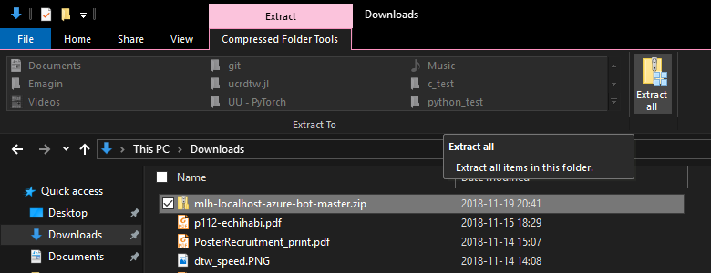
Add Project to Visual Studio Code: Windows
On a Windows computer, open the Downloads folder.
Click mlh-localhost-azure-bot-master.
Click Extract at the top.
Click Extract All.
Notes:
Bet you didn’t know Windows Explorer had a dark theme!

Slide 35
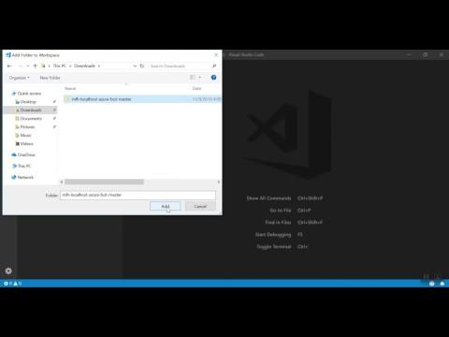
Add Project to Visual Studio Code: Windows
Open Visual Studio Code and select Add Folder.
Select this folder from your Downloads.

Slide 36
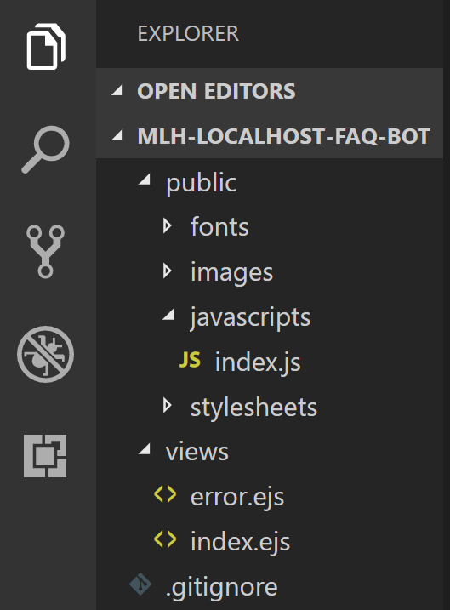
What's in this project?
public/ - this directory contains files that the browser needs to display your web app, such as fonts, CSS, images and web-browser JavaScript
views/ - contains Embedded JavaScript files .ejs which make it easier to insert data into HTML

Slide 37
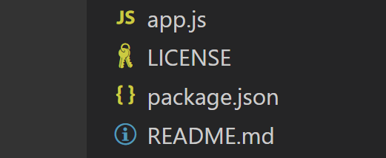
What's in this project?
app.js - this file does the hard work of our app; it requires the necessary packages, tells the app how to handle requests, and connects to the Bot
package.json - this file tells you all of the necessary node packages for the file to run
README.md - documentation describing how this code works and the setup required to run it

Slide 38
How It Works
When a user visits your website, the browser loads index.ejs. jQuery (a JavaScript library) handles the pop-up function of the chat.
The chat is an HTML form. When a user types a question and hits submit, a jQuery function sends that information to app.js.
app.js sends the request to the knowledge bot. The knowledge bot interprets the question and returns the answer to our app.
app.js sends the information back to the browser, which displays the answer to the user!

Slide 39
Let's dive deeper into the code so we understand how it works! Open app.js.

Slide 40
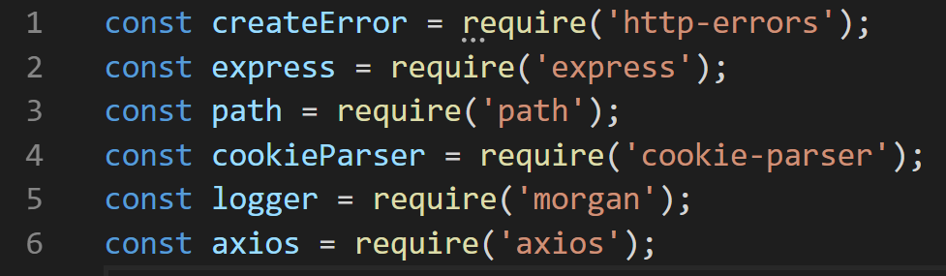
Code Review
app.js
Lines 1- 6: These declarations allow us to use Node packages for logging, working with file paths and sending requests.
‹#›

Slide 41
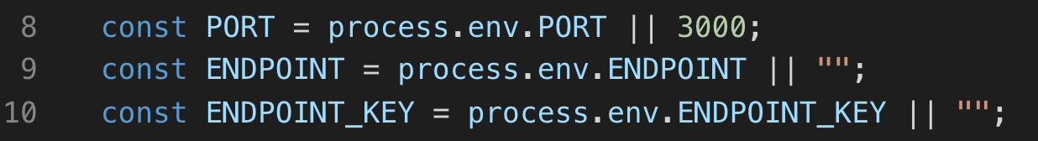
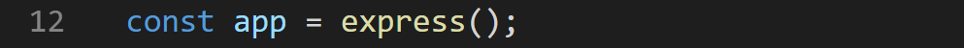
Code Review
app.js
Lines 9-10: Later in this workshop, we'll paste some information here that allows us to interact with a service hosted on Microsoft Azure. Functions lower in this file use these variables.
Line 12 creates the app which will handle sending and receiving data between the web-page and the Bot.
‹#›

Slide 42
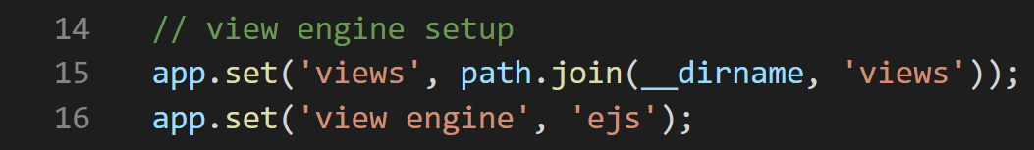
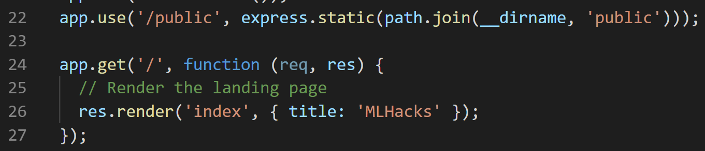
Code Review
app.js
Lines 15-16 set the path for the views and rendering method.
Line 22: Set the path for the static (non-rendered) files.
Line 24-27: When a user types the URL of our webapp, send them the home page (index.ejs).
‹#›

Slide 43
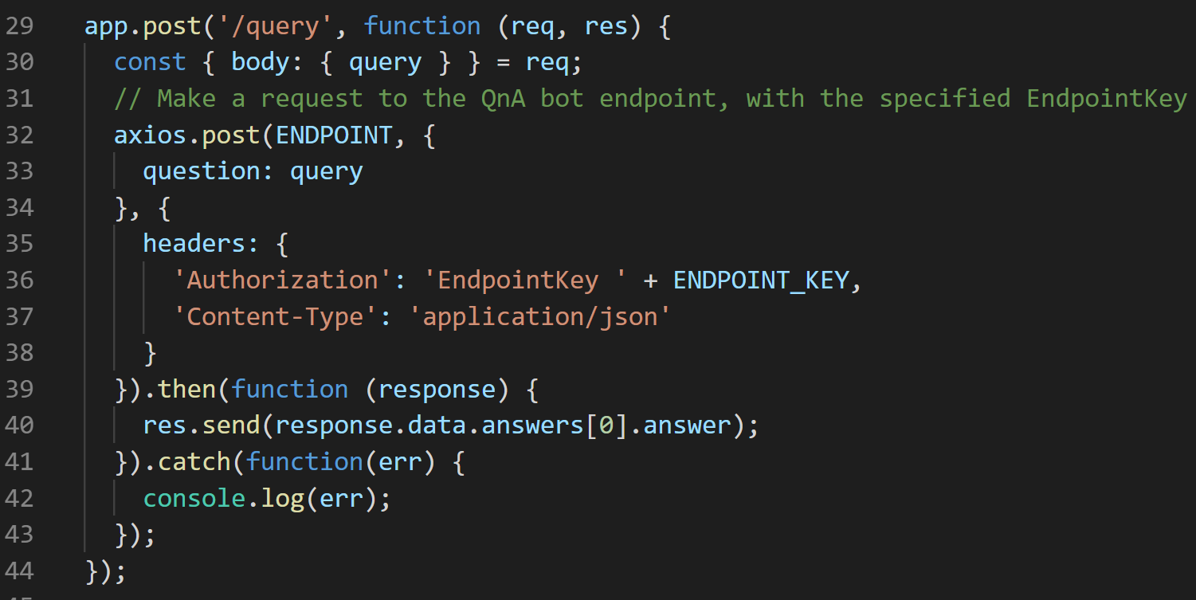
Code Review
app.js
Line 29-30: Get the question from the form.
Line 32-38: Send question input to the Azure Bot via a post request.
Line 39-40: Send the Bot response back to the web-page.
‹#›
Notes:
“post“ refers to HTTP, but let’s just assume it’s how to talk to a server

Slide 44
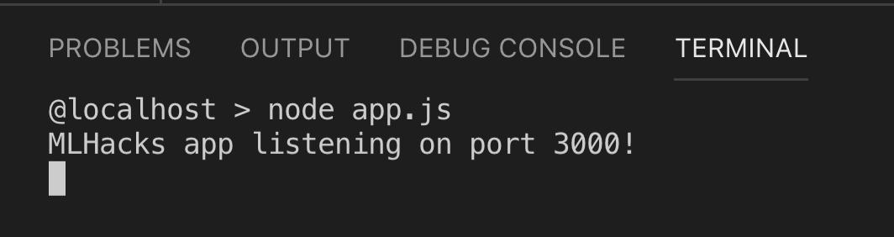
Code Review
app.js
The final line of app.js starts the app and log its success to the terminal!
‹#›

Slide 45
Okay! That’s how we handle the requests and the responses. But, where do the requests actually come from?
The form on the webpage! Let's look at index.ejs.

Slide 46
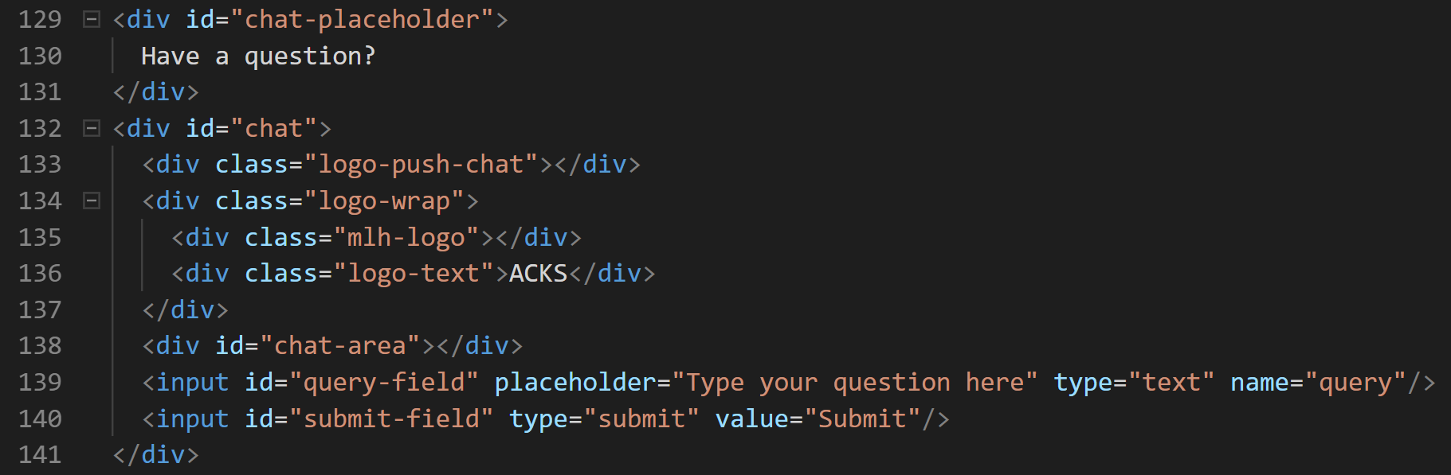
Code Review: views/index.ejs
index.ejs
Creates a simple form (the place where you typed questions).
On Line 139, the question field has the attribute name with the value query.
Submitting this form calls the query event handler in app.js,which sends the question to our bot!
‹#›

Slide 47
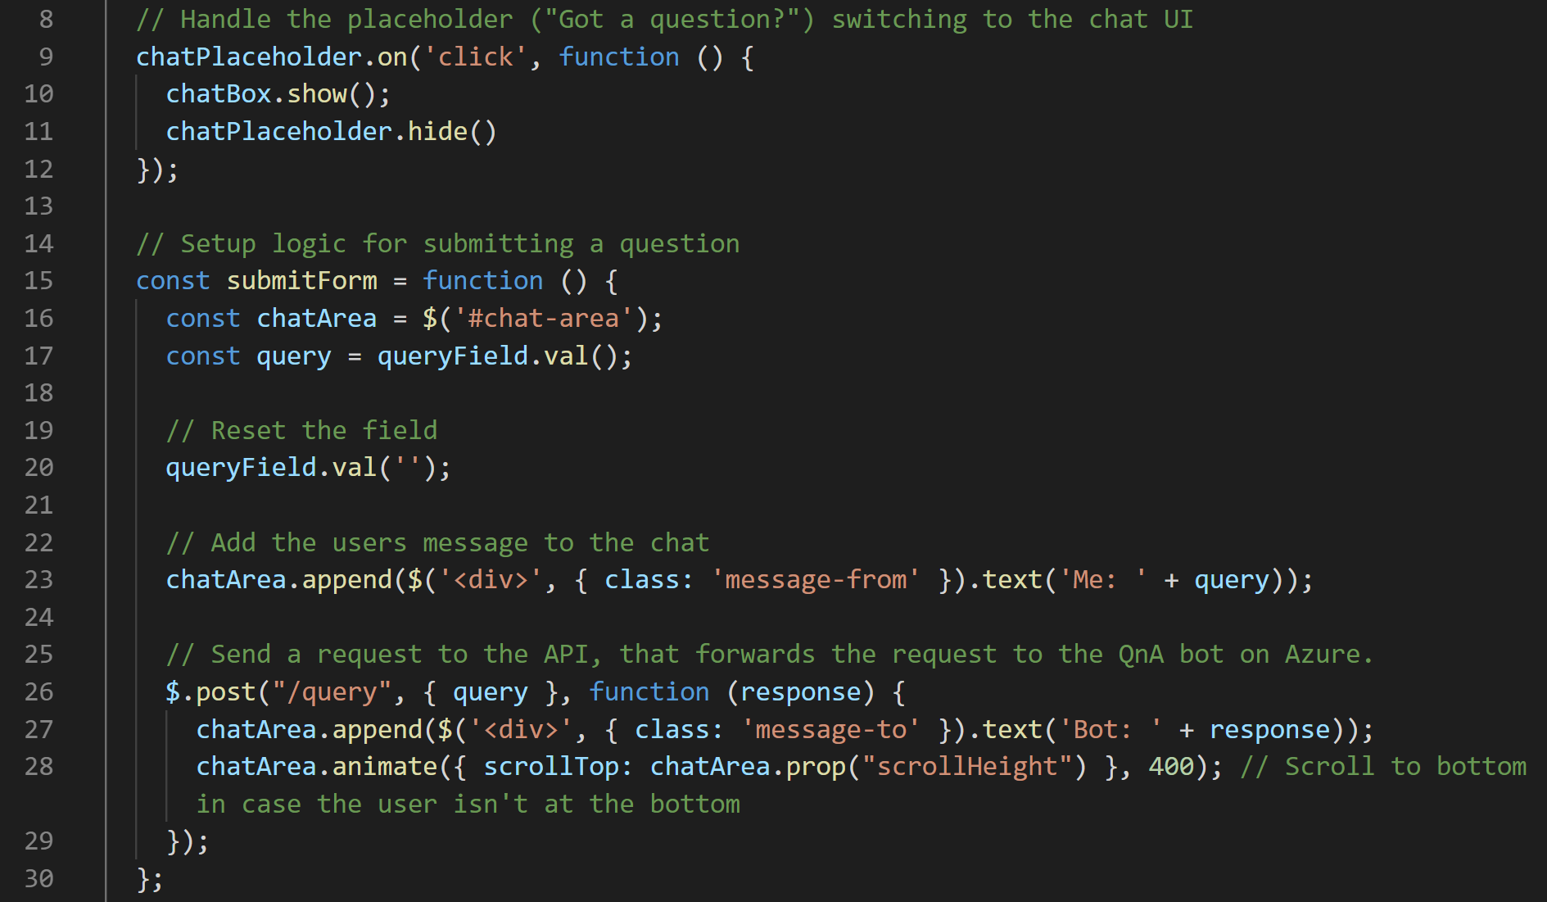
Code Review: public/javascripts/index.js
index.js
Makes our chat form functional and react to user actions (sending message, closing chat).
‹#›

Slide 48
That was a lot of reading...
Let’s actually test this thing!

Slide 50
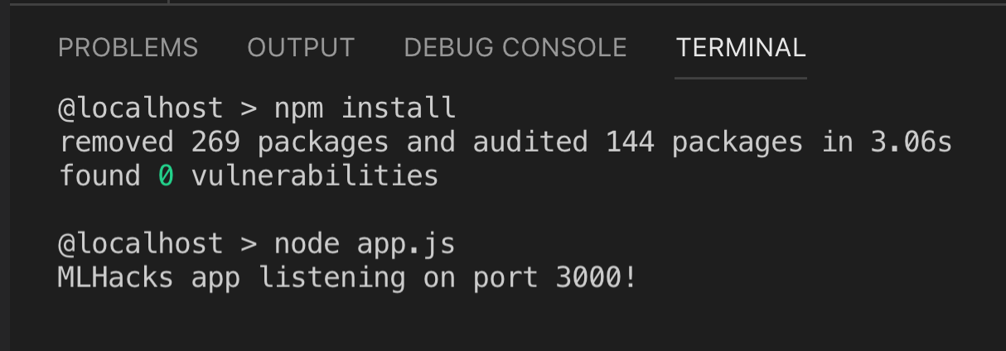
Testing the app locally
Open your Visual Studio Code terminal.
Type pwd to make sure you are in mlh-localhost-azure-bot-master.
Install requirements using npm install
Start the app using node app.js.
Visit localhost:3000 in your browser and try the app!

Slide 51
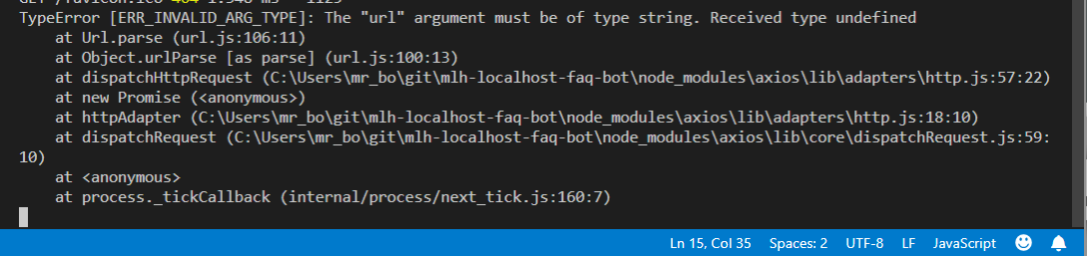
Nothing happens ):
Check the VSCode terminal for errors:
We forgot to set up our questions and answers!

Slide 53
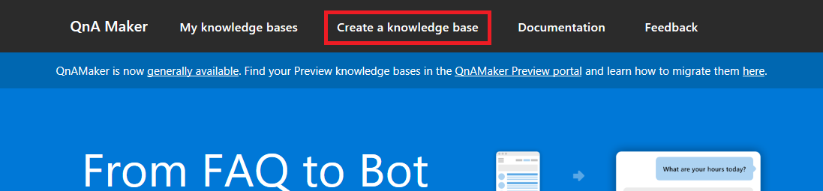
Make Your Bot
We need a knowledge base of Questions and Answers to train our bot.
Go to qnamaker.ai and create one!

Slide 54
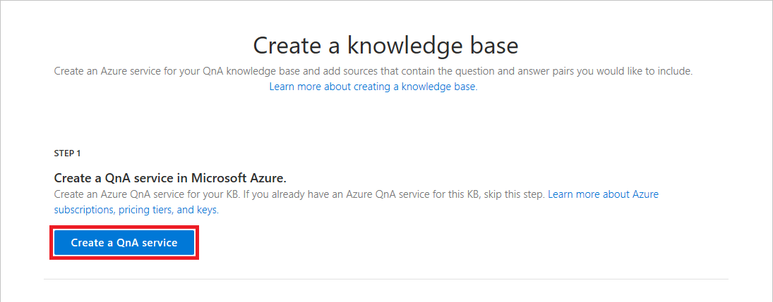
Create an QnA service
First, we need to create a service on Azure to host our Q+A. When you select Create a QnA service, a new tab will open.

Slide 55
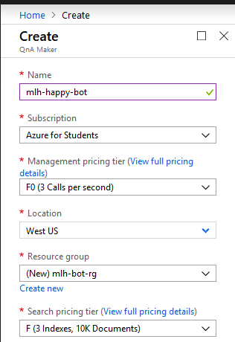
Create an QnA service
You Azure Portal was opened so that you can create a new resource. Give your factbot a unique name.
Choose West US for the all locations.
Select F0 for the pricing tier. Note: You MUST do steps 3 and 4 in this order.
Select Create new and name your resource group.
Select the lowest Search pricing tier.

Slide 56
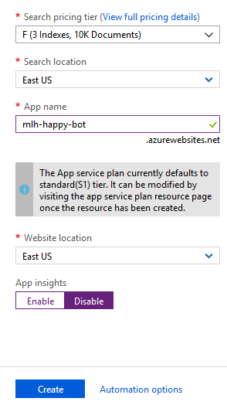
Create an QnA service
Select East US as the Search location.
Your App name will be auto-created.
Select East US as Website location.
Disable App insights.
Select Create, then wait until the page changes to your dashboard.

Slide 57
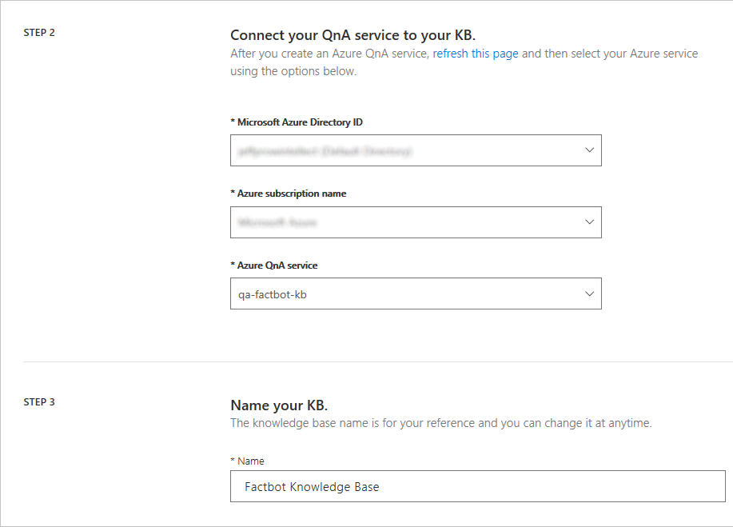
Connect QnA Service
Now we need to connect our QnA Service to our Knowledge Base.
Return to the other tab. Refresh.
Select your account name from Microsoft Azure Directory.
Select the QnA service you made.
Name your knowledge base.
Notes:
Note that after Step 2 participants have to refresh the page to have their service show up in the Azure Service section

Slide 58
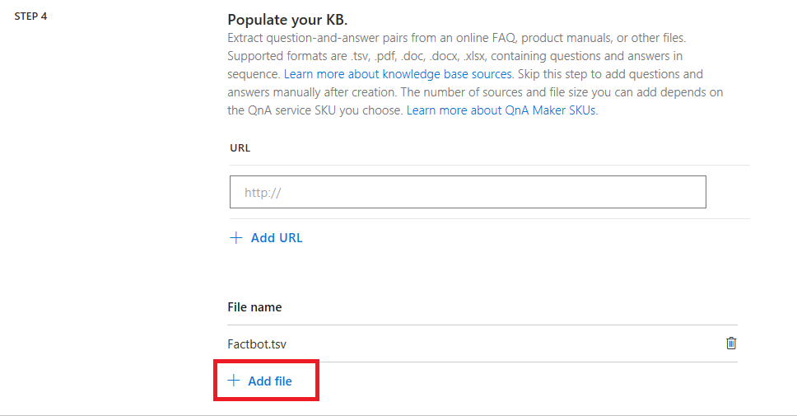
Train Your Bot
http://mlhlocal.host/azure-bot-faq
Get the sample FAQs from the URL above.
Download this file in .xlsx format.
Open the file, edit it with your own questions and answers if you wish, then upload it.
Notes:
Choose whichever tone of voice for your bot that you want!

Slide 59
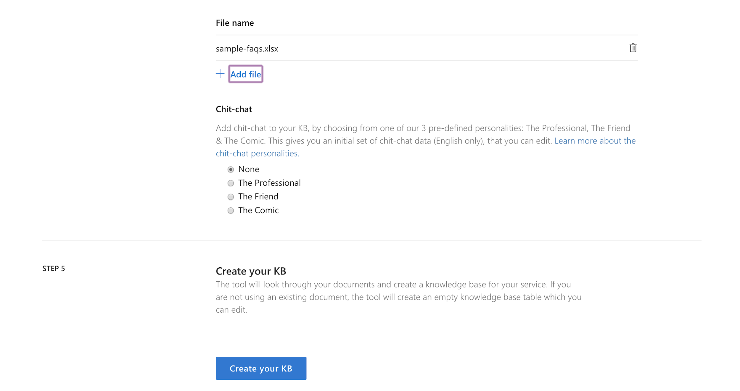
Train Your Bot
Add a chit-chat bot if you wish.
Select Create your KB.

Slide 60
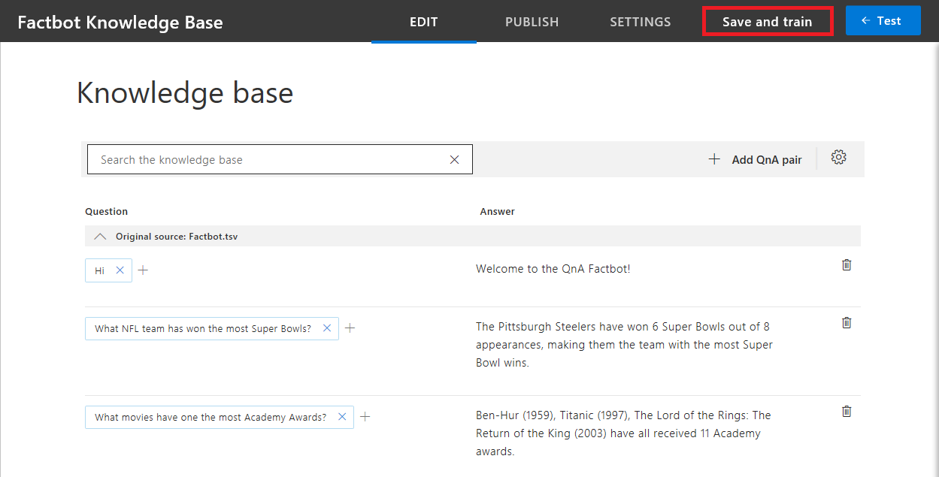
Train Your Bot
Make sure your questions and answers loaded properly, then click Save and train.

Slide 61
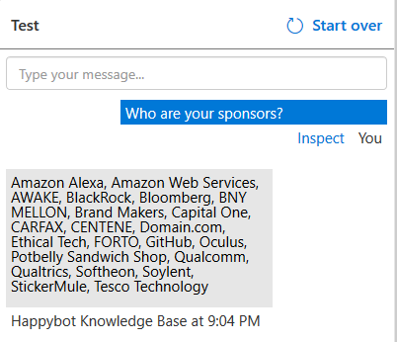
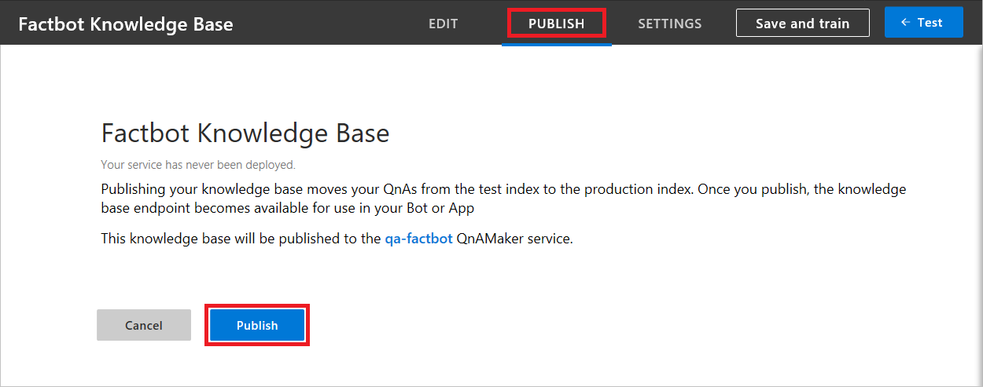
Test Your Bot
12. Type some test messages.
11. Open the test dialog.
If you’re not happy with the results, edit your Knowledge Base!

Slide 62
Publish Your Bot
13. Make your bot accessible by your web app!

Slide 63
Amazing! Your Knowledge Base is being published. The next screen that pops up will have some information to copy into our code in Visual Studio Code for our app to communicate with our knowledge base.

Slide 64
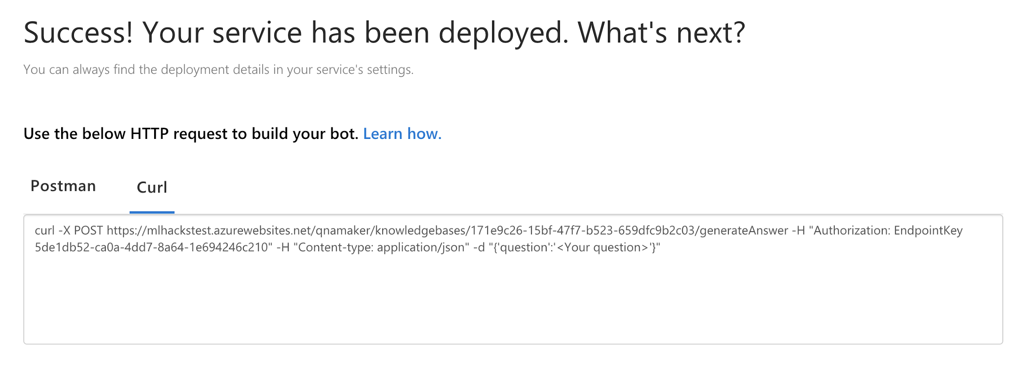
Get Codes for Testing Locally
Select Curl.
Copy the URL.
Return to app.js in Visual Studio Code.

Slide 65
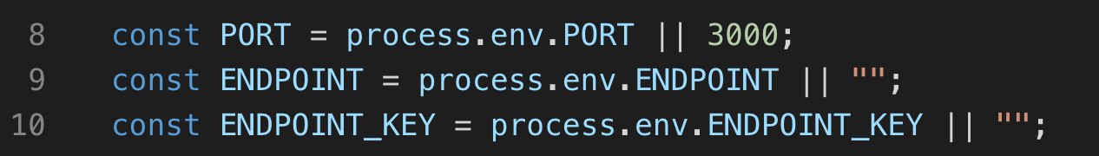
Let's try this again!
Open app.js.
On Line 9, inside of the quotation marks, paste the value you just copied. This tells our app where our knowledge base is.
Return to QnAMaker.
app.js

Slide 66
Get Codes for Testing Locally
Copy the EndpointKey.
Return to app.js
On Line 10, inside of the quotation marks, paste the value of ENDPOINT_KEY. This tells the knowledge base that we are authorized to use it.
Save your changes.
app.js

Slide 67
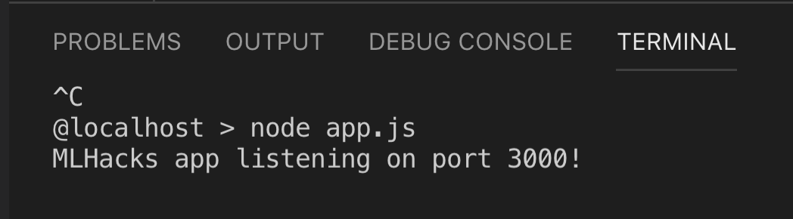
Let's see if it changed!
Return to your Visual Studio Code terminal. Your app might still be running. Type [CTRL] [C] to stop it.
Run app using node app.js.
Visit localhost:3000 in your browser.
Test it out!

Slide 68
It's working! But the answer you got when the bot didn't know how to answer your question was sort of generic. Let's customize that!

Slide 69
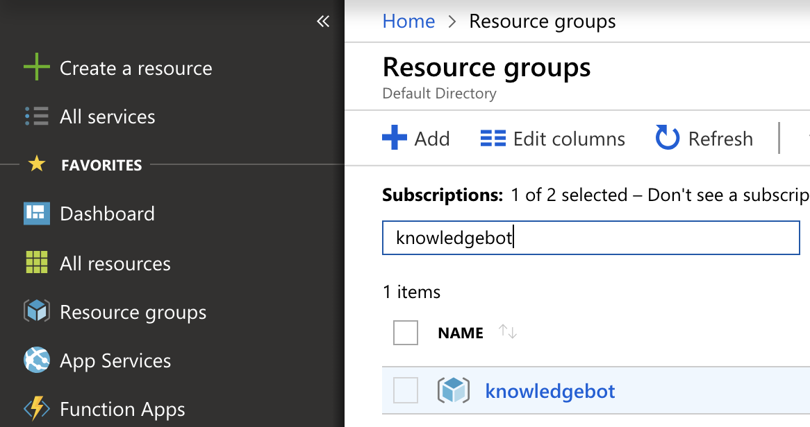
Default Answer
Return to your Azure Portal.
Select Resource Groups -> the resource group you made.

Slide 70

Default Answer
Select the App Service (NOT the App Service plan).

Slide 71

Default Answer
Select Application Settings.
Scroll to the Application settings section of this panel.
Locate DefaultAnswer. Select Click to edit.
Change it to whatever you want, then select Save.

Slide 72
Let's see if it changed!
Return to your Visual Studio Code terminal. Your app might still be running. Type [CTRL] [C] to stop it.
Run app using node app.js.
Visit localhost:3000 in your browser.
Test it out!

Slide 73
Not everyone is going to use the same words to ask a question!
Let's use another cool feature of QnAMaker.

Slide 74

Multiple Versions of Questions
Return to QnA Maker and open your knowledge base.

Slide 75


Multiple Versions of Questions
Next to any question, select the +.
Type the same question in a different phrasing.
Do this for as many answers as you would like.

Slide 76

Multiple Versions of Questions
When you're satisfied, select Save and train in the top corner.
Then select PUBLISH.

Slide 77
Let's see if it changed!
Return to your Visual Studio Code terminal. Your app might still be running. Type [CTRL] [C] to stop it.
Run app using node app.js.
Visit localhost:3000 in your browser.
Test it out!

Slide 78
Sometimes your bot gives you an answer and the answer is wrong. The knowledge bot actually lets us know how "confident" it is about a certain answer.
Let's grab those confidence scores!

Slide 79

Confidence Score
Return to app.js in Visual Studio Code.
Add Line 41.
If you want a challenge, add some logic! For example, if the confidence score is below 50, maybe your bot adds, "but I am not very sure." to the response!
app.js

Slide 80
Let's see if it changed!
Return to your Visual Studio Code terminal. Your app might still be running. Type [CTRL] [C] to stop it.
Run app using node app.js.
Visit localhost:3000 in your browser.
Test it out!

Slide 81
You now have a really cool FAQ bot up and running!
Let's deploy your app to Microsoft Azure.

Slide 82


Create an App Service Plan
Return to portal.azure.com
Select Create a Resource then search for "App Service Plan".
Select App Service Plan then click Create in the panel that opens.
Notes:
We have a public app, so we want everyone to access it. If you were deploying something which should only be used by people inside a certain company, you would actually need to configure this.

Slide 83

Create an App Service Plan
In the panel that opens, name your service plan.
Make a new Resource Group.
Select Linux as your operating system.
Select East US.
Click Pricing tier.
Notes:
We have a public app, so we want everyone to access it. If you were deploying something which should only be used by people inside a certain company, you would actually need to configure this.

Slide 84


Create an App Service Plan
Select Dev/Test.
Select B1.
Select Apply.
When the previous screen returns, select Create. Wait a minute or two for that to finish deploying, then we'll create the resource for the MLHacks Web App!
Notes:
We have a public app, so we want everyone to access it. If you were deploying something which should only be used by people inside a certain company, you would actually need to configure this.

Slide 85
Make sure the App Service Plan has finished deploying before moving on to the next steps!

Slide 86

Deploy Your App to Microsoft Azure
Now, let's deploy the FAQBot app!
Navigate to your Azure dashboard and select Create a resource then Web then Web App.

Slide 87

Deploy Your App to Microsoft Azure
In the panel that opens, name your app something unique.
Select the Resource Group you made previously.
Select Linux as your operating system.
Select Node.js 10.10 as your Runtime Stack.
Click Create at the bottom of the screen.

Slide 88

Deploy Your App to Microsoft Azure
On the left side of your Azure portal, select All resources.
Click the Web App you just made.
Select Deployment Center.

Slide 89

Deploy Your App to Microsoft Azure
Scroll to select Local Git. Select Continue.

Slide 90

Deploy Your App to Microsoft Azure
Select App Service Kudu build server then select Continue then Finish.

Slide 91

Deploy Your App to Microsoft Azure
Select Deployment Credentials then User Credentials.
Create a Username and Password.

Slide 92

Deploy Your App to Microsoft Azure
You will know the previous step was successful if the Uri changes.

Slide 93


Deploy Your App to Microsoft Azure
In Visual Studio Code, click the source control symbol.
Then, click the symbol next to SOURCE CONTROL.
Click Initialize Repository.

Slide 94

Deploy Your App to Microsoft Azure
Type "First Commit" above CHANGES.
Click the checkmark.
Click Yes if you get a modal asking about staging changes.

Slide 95

Deploy Your App to Microsoft Azure
In your Deployment Center tab, copy the Git clone Uri.
In your terminal, type git remote add origin and paste what you just copied.

Slide 96


Deploy Your App to Microsoft Azure
Click the ellipses (. . .) near SOURCE CONTROL.
Select Publish Branch.
Enter the Password you created when prompted.

Slide 97

Deploy Your App to Microsoft Azure
Back in Azure Deployment Centre, you can see that your deploy is in progress!

Slide 98

Deploy Your App to Microsoft Azure
When the build has finished, select Overview.
Click the URL for your web app, and try it live!

Slide 99
Amazing Work!

Slide 101
Let’s recap quickly...
1
Bots can answer simple questions for your users.
2
Azure Bots can be queried via API requests.
3
Azure can host your bots and webapps.

Slide 102
What did you learn today?
We created a fun quiz to test your knowledge and see what you learned from this workshop.
http://mlhlocal.host/quiz

Slide 104
Keep Learning: Practice Problems for Later
Extra Practice Problem 1:
Add more questions! Keep improving your knowledge base.
Extra Practice Problem 2:
Add Language Understanding to your bot: mlhlocal.host/azure-luis
Notes:
What to Say:
Read the slide.
What to Do:
Encourage participants to try these problems on their own.

Slide 105

Learning shouldn't stop when the workshop ends...
Check your email for access to:
These workshop slides
Practice problems to keep learning
Deeper dives into key topics
Instructions to join the community
More opportunities from MLH!

Slide 106
v.0.0.1

